Slide 1

Heart Disease Prediction Using Machine Learning
By Vipul Arora

Slide 2


Problem Statement
The major challenge in heart disease is its detection.
Early detection of cardiac diseases can decrease the mortality rate and overall complications.
Since we have a good amount of data in today’s world, we can use various machine learning algorithms to analyze the data for hidden patterns.

Slide 3

What is a heart attack ?
Definition: A heart attack, or myocardial infarction, occurs when there is a blockage in the blood flow to the heart muscle.
Cause: It is typically caused by a blood clot that forms in a coronary artery, which supplies oxygen-rich blood to the heart.
Symptoms: Common symptoms include chest pain or discomfort (tightness, pressure, squeezing), shortness of breath, pain or discomfort in the arms, back, neck, jaw, or stomach, lightheadedness, nausea, and cold sweats.
Risk Factors: Factors such as age, family history, smoking, high blood pressure, high cholesterol, diabetes, obesity, physical inactivity, and excessive stress increase the risk.
Treatment: Prompt treatment aims to restore blood flow and may include medications, oxygen therapy, angioplasty, stenting, or coronary artery bypass surgery.
Recovery and Rehabilitation: A comprehensive cardiac rehabilitation program is often recommended post-heart attack.
Prevention: Maintaining heart health through lifestyle modifications, healthy diet, exercise, avoiding smoking, and managing stress is essential.

Slide 4
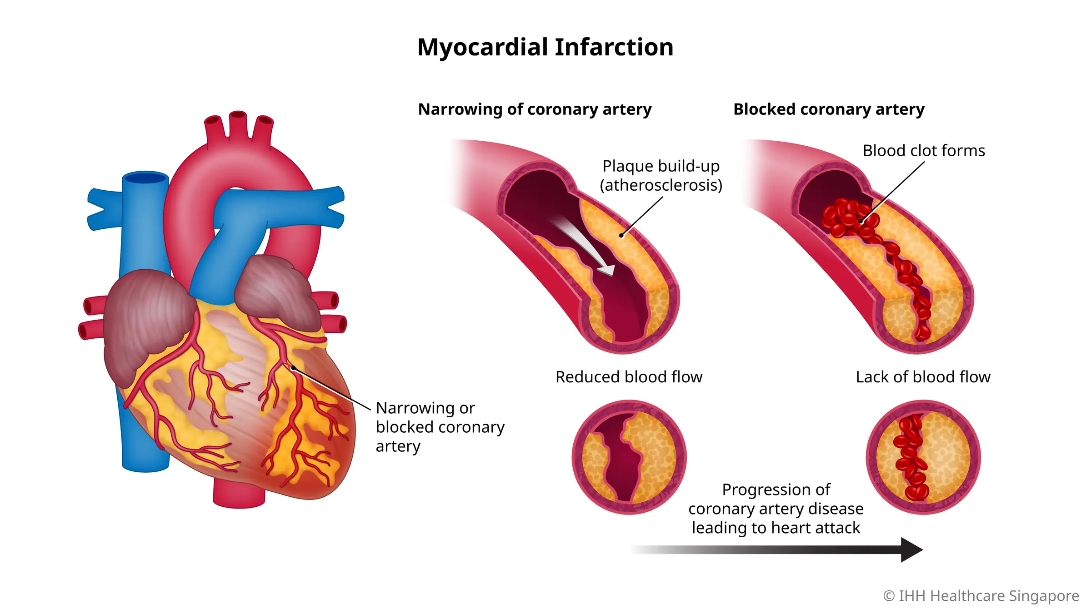
How does a heart attack occur?
Blockage Formation: A heart attack, or myocardial infarction, occurs when there is a blockage in the blood flow to the heart muscle.
Blood Clot Formation: Sometimes, the plaque becomes unstable and ruptures, leading to the formation of a blood clot at the site of the rupture.
Complete or Partial Blockage: The blood clot can partially or completely block the coronary artery, obstructing the blood flow to the heart muscle.
Lack of Oxygen: When the blood flow is restricted or blocked, the heart muscle does not receive sufficient oxygenand nutrients.
Ischemia and Tissue Damage: The lack of oxygen and nutrients leads to ischemia (insufficient blood supply) and subsequent damage or death of the heart muscle tissue.
Severity and Location of Blockage: The severity and location of the blockage determine the extent of the heart attack and its potential impact on overall heart function.
Prompt Medical Attention: Recognizing the symptoms of a heart attack and seeking immediate medical help is crucial to minimize damage and improve outcomes.

Slide 5
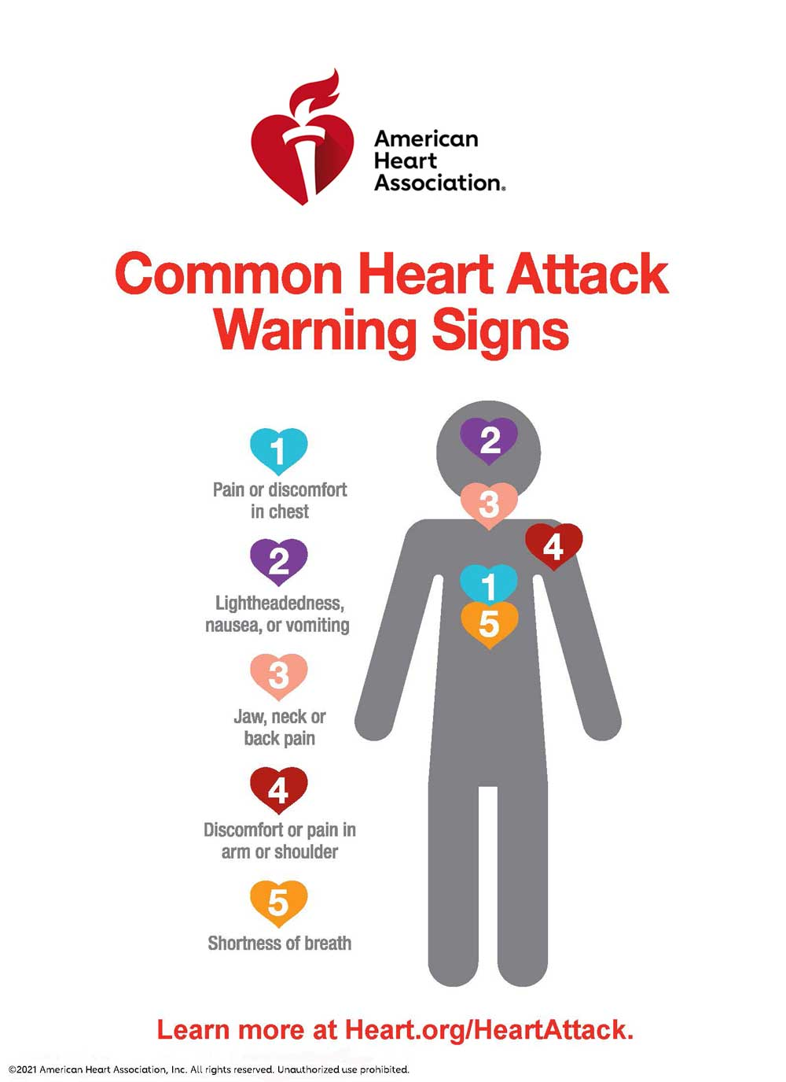
Heart attack symptoms
Chest Discomfort: The most common symptom of a heart attack is chest pain or discomfort. It may be described as a feeling of tightness, pressure, squeezing, or heaviness in the chest.
Upper Body Pain: Pain or discomfort may also extend beyond the chest to other areas, such as the arms (usually the left arm, but can also affect the right arm), back, neck, jaw, or stomach.
Shortness of Breath: Many people experience shortness of breath or have difficulty catching their breath during a heart attack. This can occur along with or without chest pain.
Nausea and Sweating: Nausea, vomiting, and sweating are common symptoms that some individuals may experience during a heart attack. These symptoms can be accompanied by a sense of dizziness or lightheadedness.
Fatigue and Weakness: Unexplained fatigue or weakness can be a symptom of a heart attack, particularly among women or older adults.
Anxiety and Restlessness: Feelings of anxiety or restlessness can sometimes occur during a heart attack. Individuals may have a sense of impending doom.
Silent Heart Attack: In some cases, a heart attack can be asymptomatic or present with mild symptoms that are easily overlooked. These "silent" heart attacks can occur without noticeable chest pain but still cause damage to the heart.

Slide 6

Data Analysis
This comprehensive analysis of the heart attack dataset seeks to uncover critical insights into heart disease prediction, combining rigorous EDA, correlation and prediction tasks.
The dataset, composed of both categorical and numerical data, provides a comprehensive snapshot of factors potentially contributing to heart diseases, including demographic details like :
Age o Sex
exang: exercise induced angina
ca: number of major vessels
cp: Chest Pain type
Typical angina. Non-anginal pain
Atypical angina Asymptomatic
trtbps: resting b lood pressure (in mm Hg)
chol: cholestoral in mg/dl fetched via BMI sensor
fbs: (fasting blood sugar > 120 mg/dl)
rest_ecg: resting electrocardiographic results
Normal, ST-T wave abnormality, Left ventricular hypertrophy (LVH)
thalach: maximum heart rate achieved
target: heart attack
oldpeak - ST depression induced by exercise relative to rest
slope - the slope of the peak exercise ST segment
Upsloping, Flat, Downsloping

Slide 7
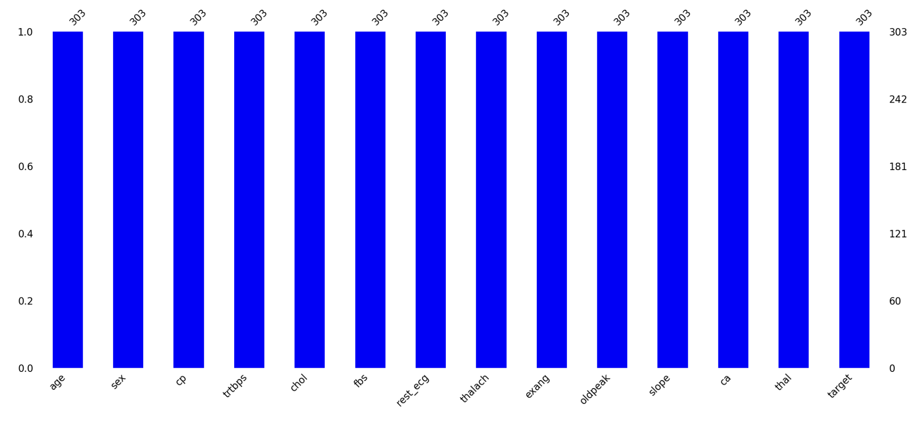
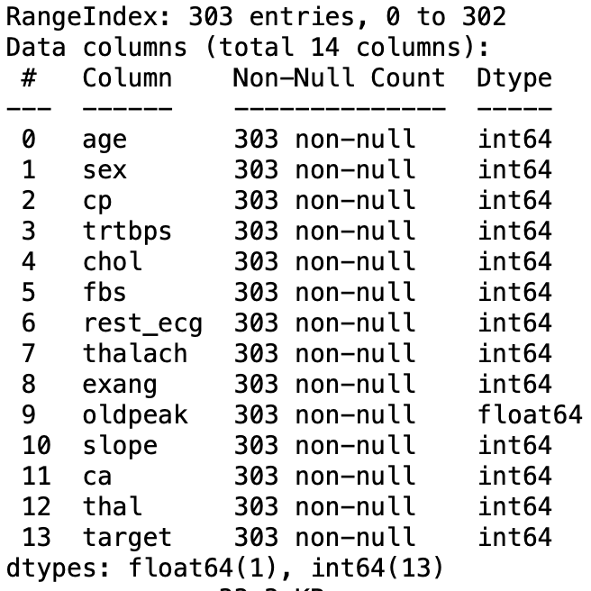
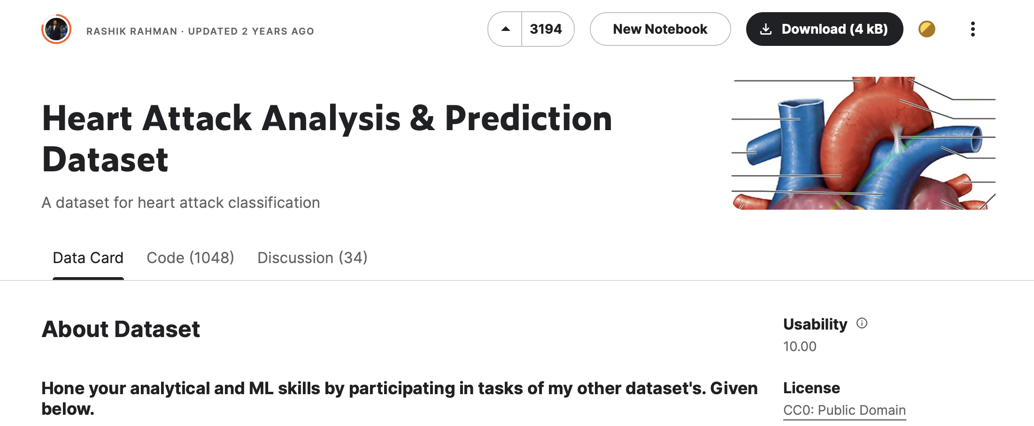
Lets look at the Data
The Data Set consists of 303 Rows and 14 Columns.
The type of all the variables in the data set are in numerical format.
According to first impressions, there is no missing value in the data set.
SOURCE : https://www.kaggle.com/datasets/rashikrahmanpritom/heart-attack-analysis-prediction-dataset

Slide 8
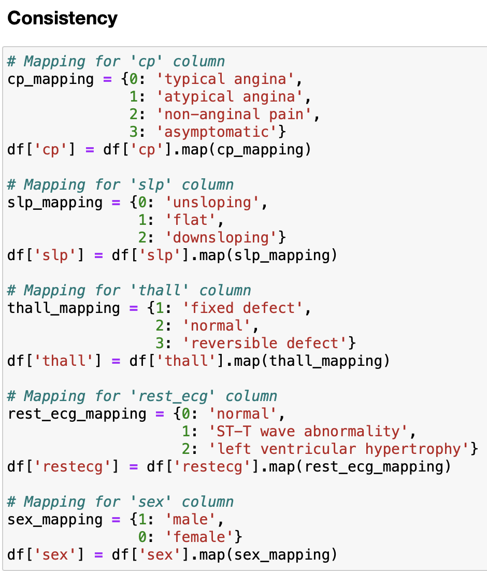
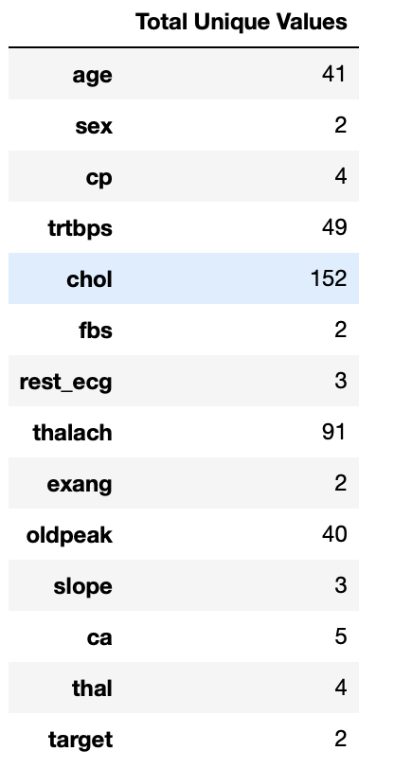
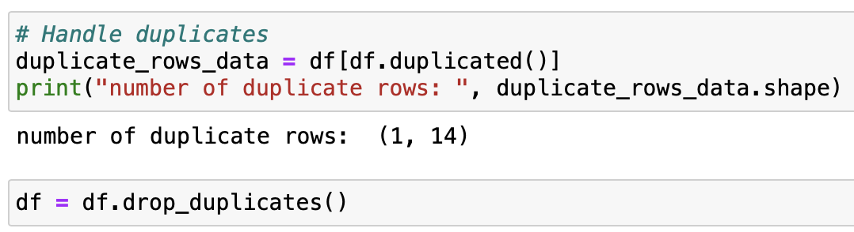
Data Cleaning

Slide 9
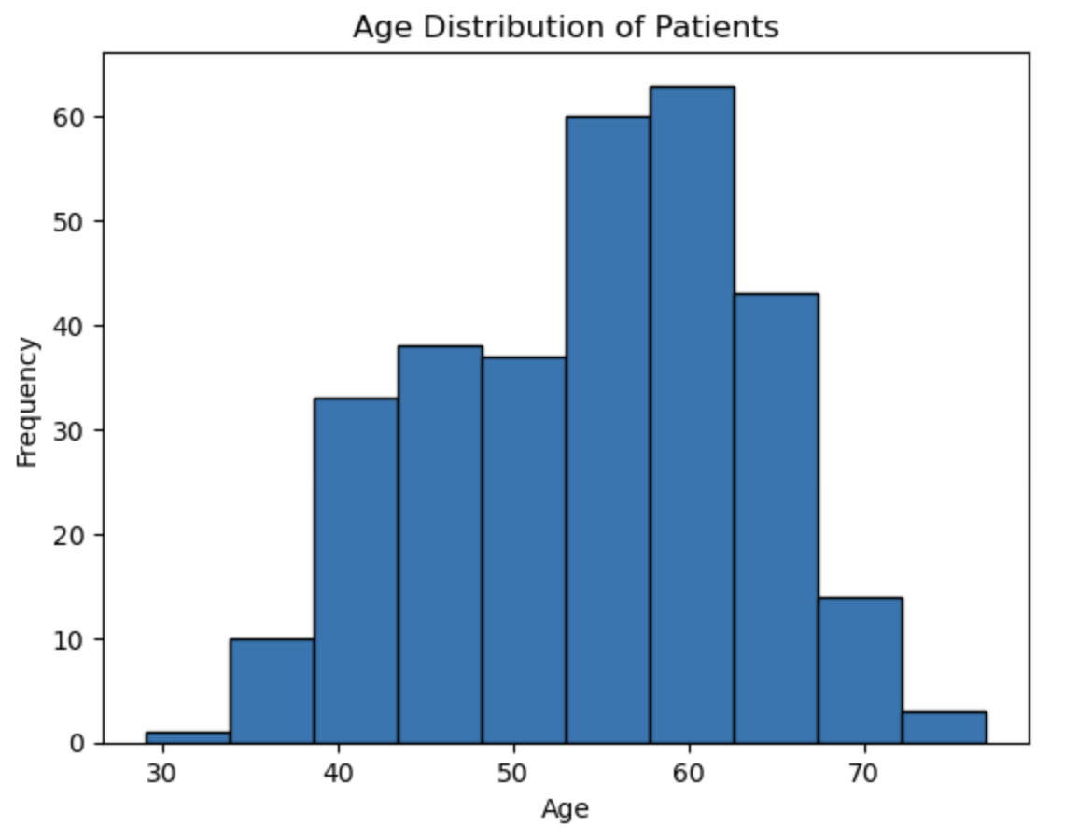
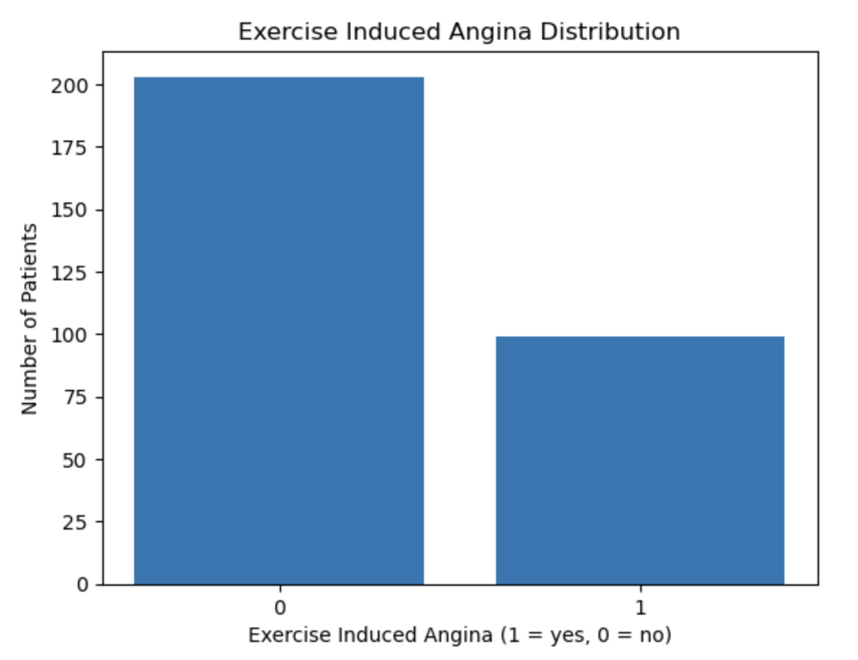
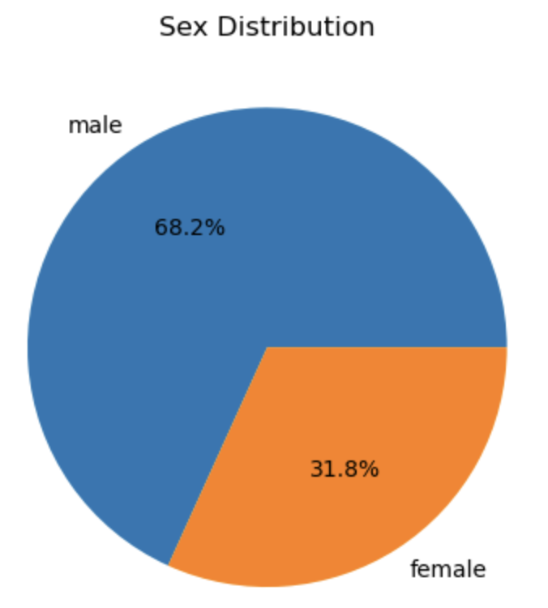
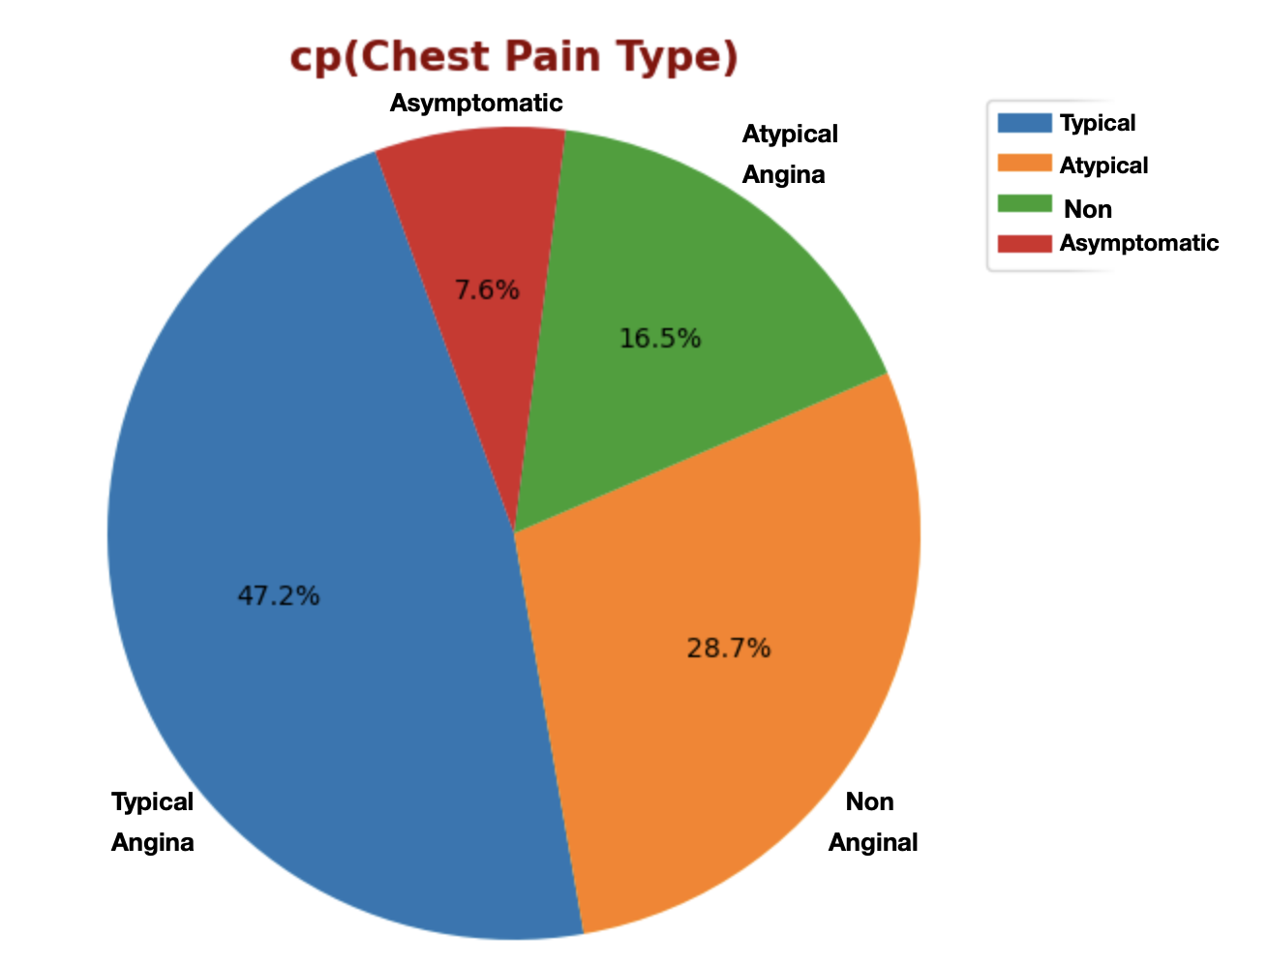
Univariate Analysis

Slide 10
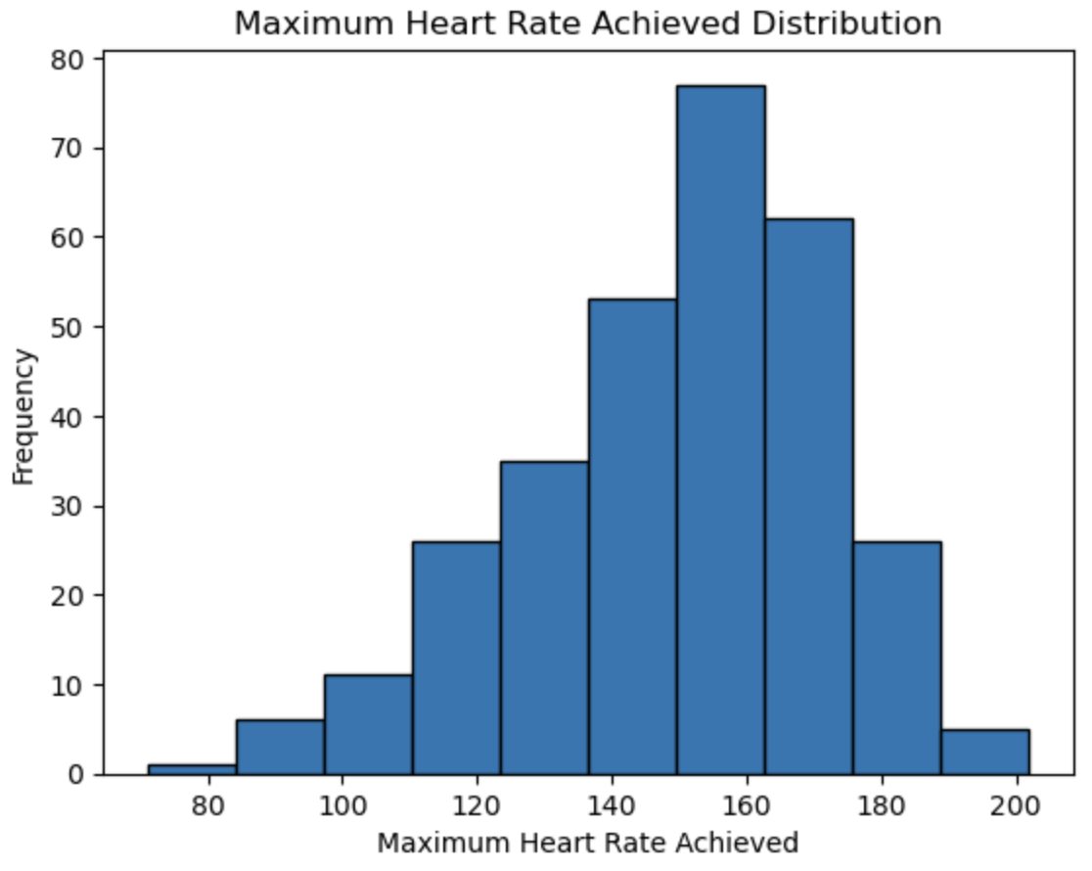
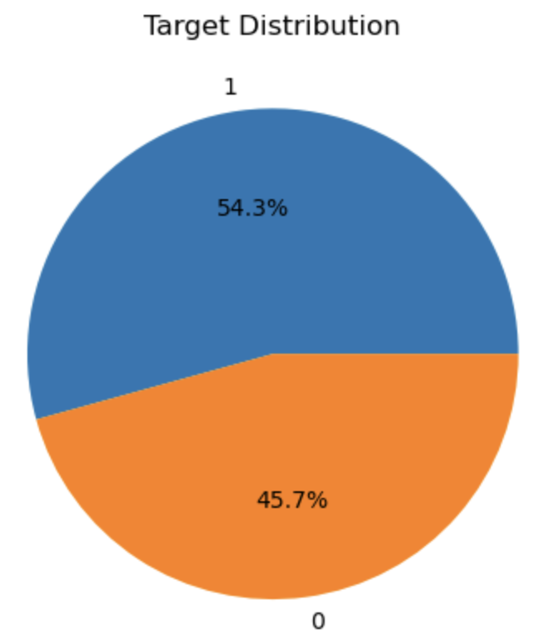
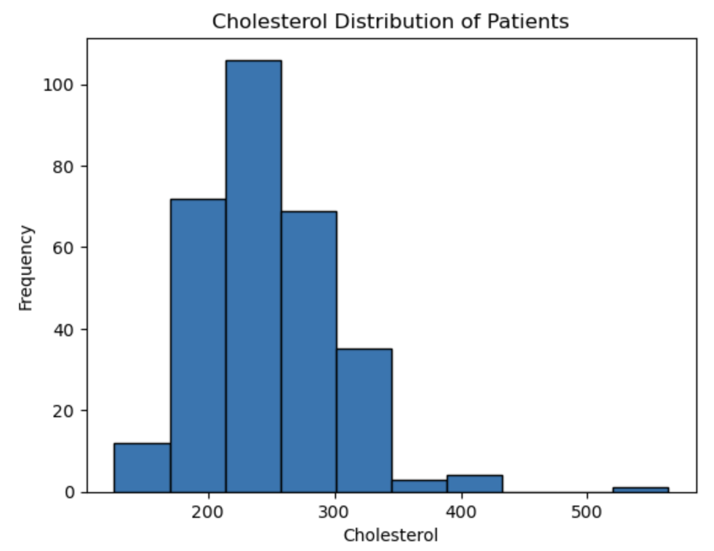
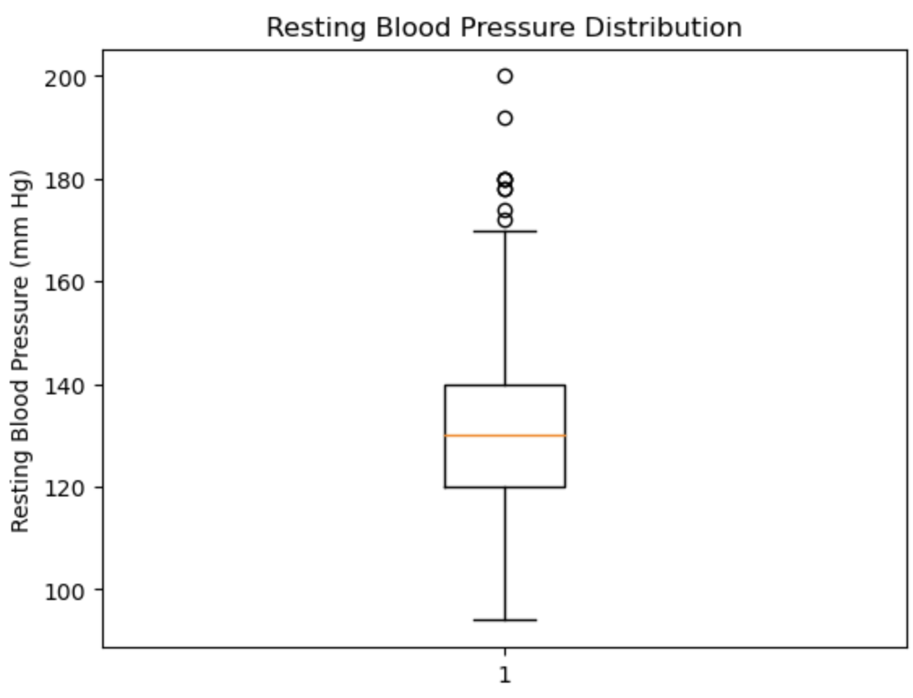
Univariate Analysis

Slide 11
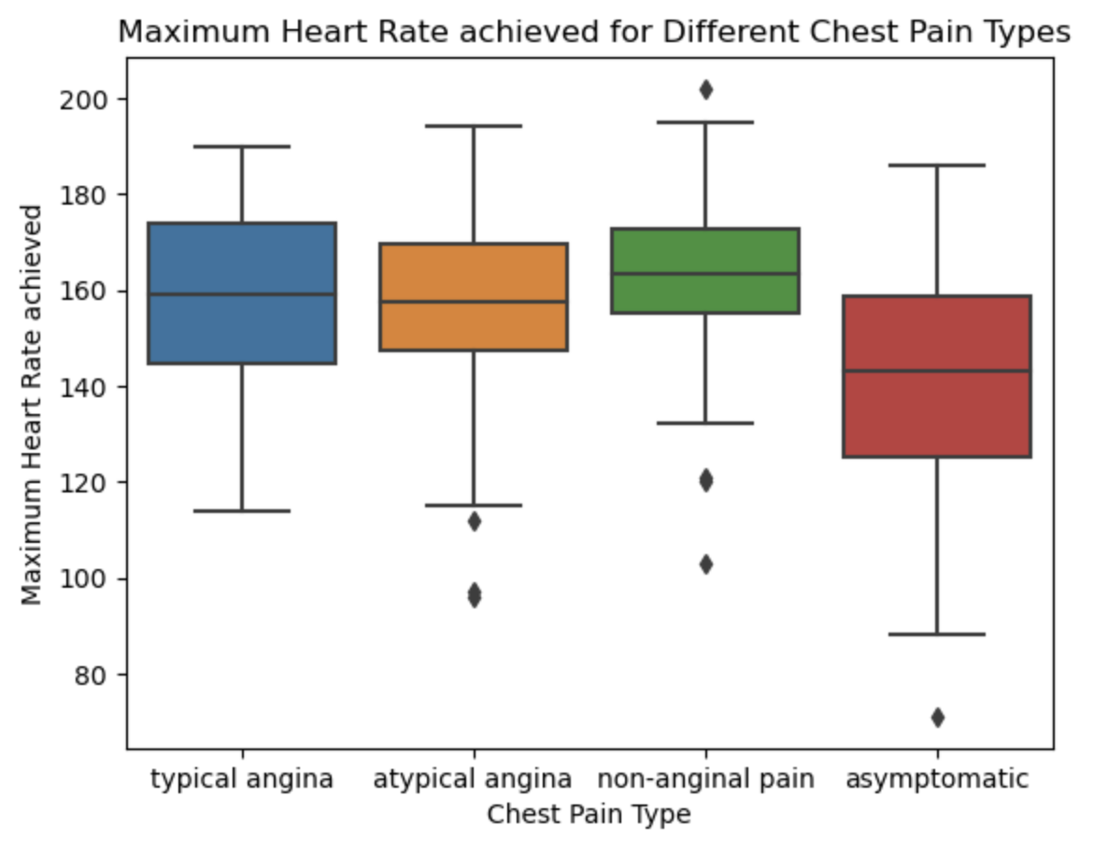
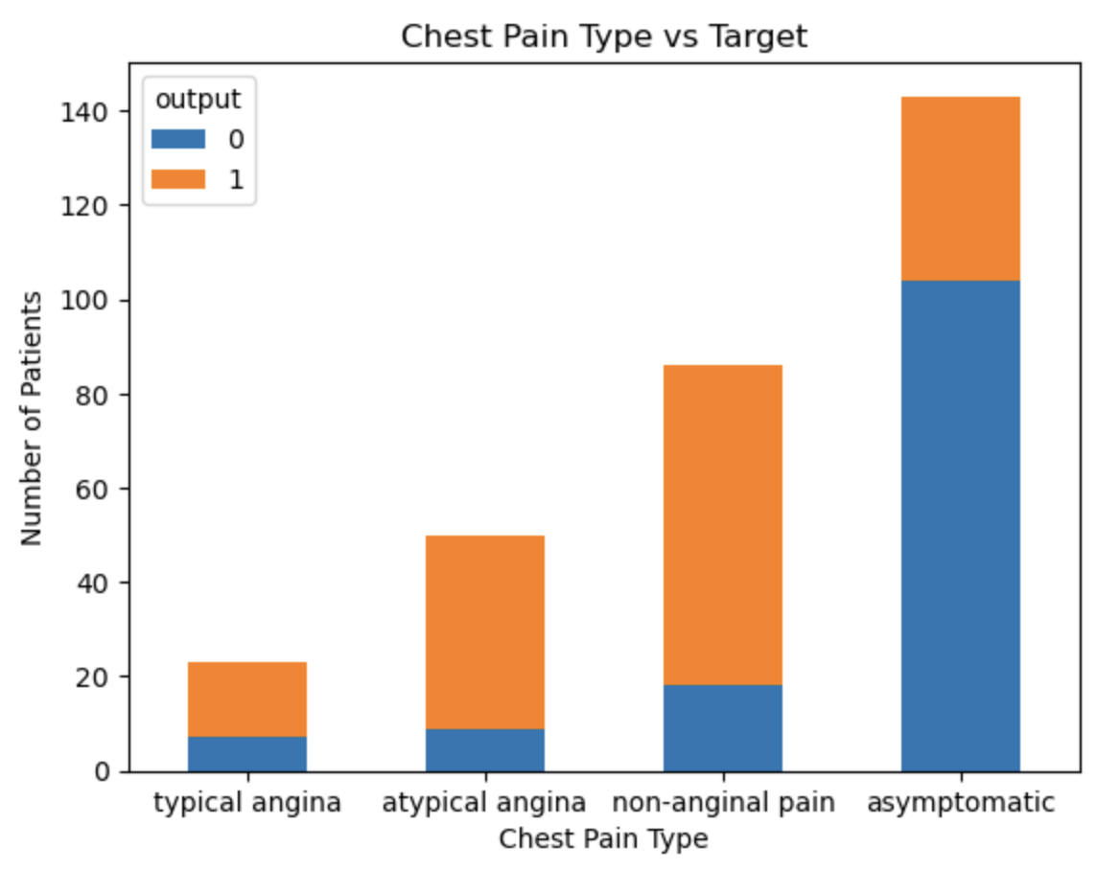
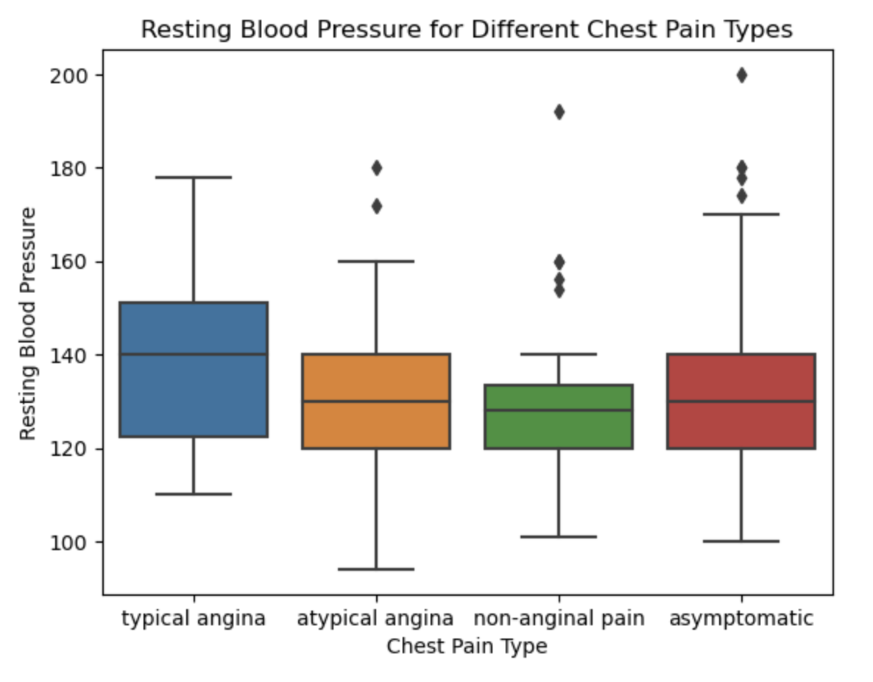
Bivariate Analysis

Slide 12
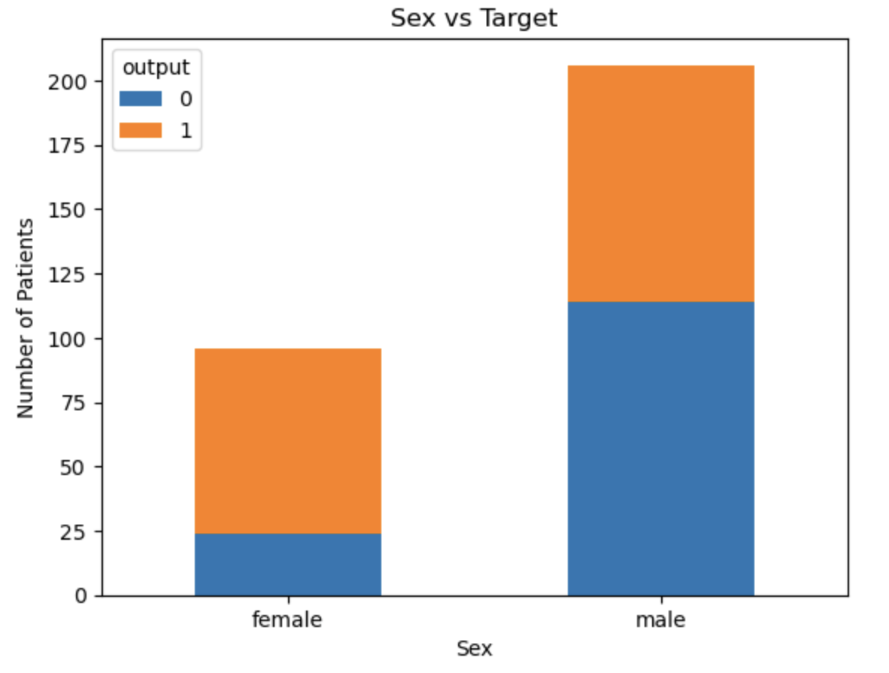
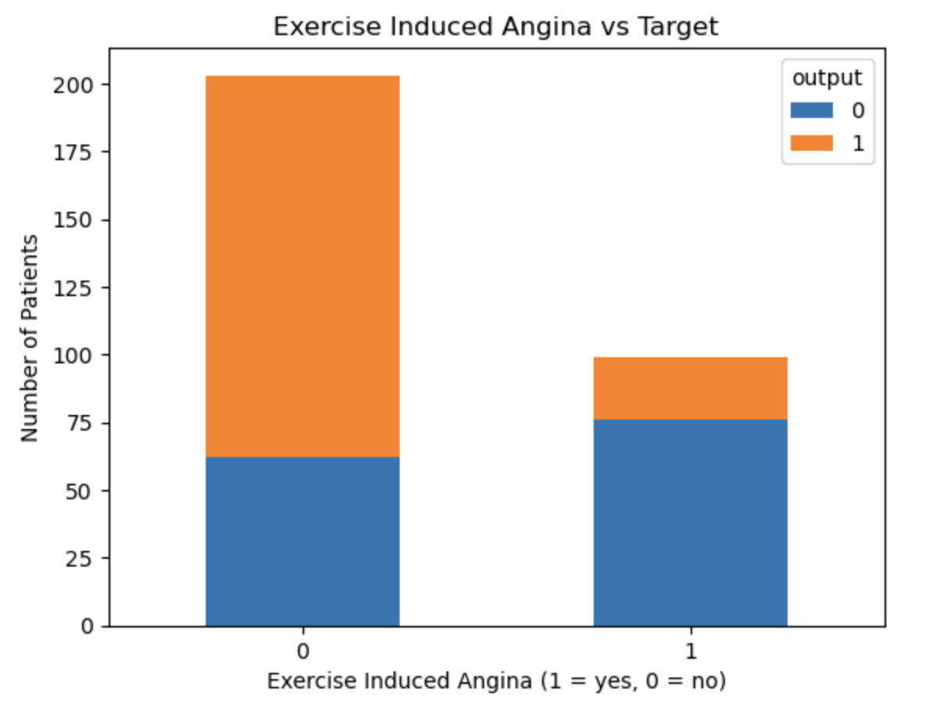

Slide 13
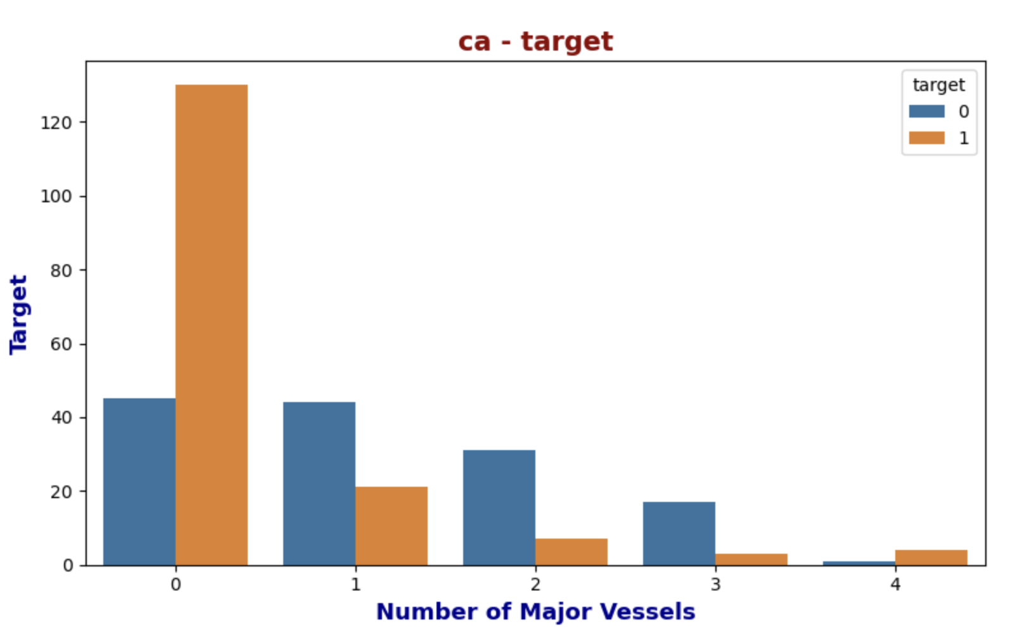
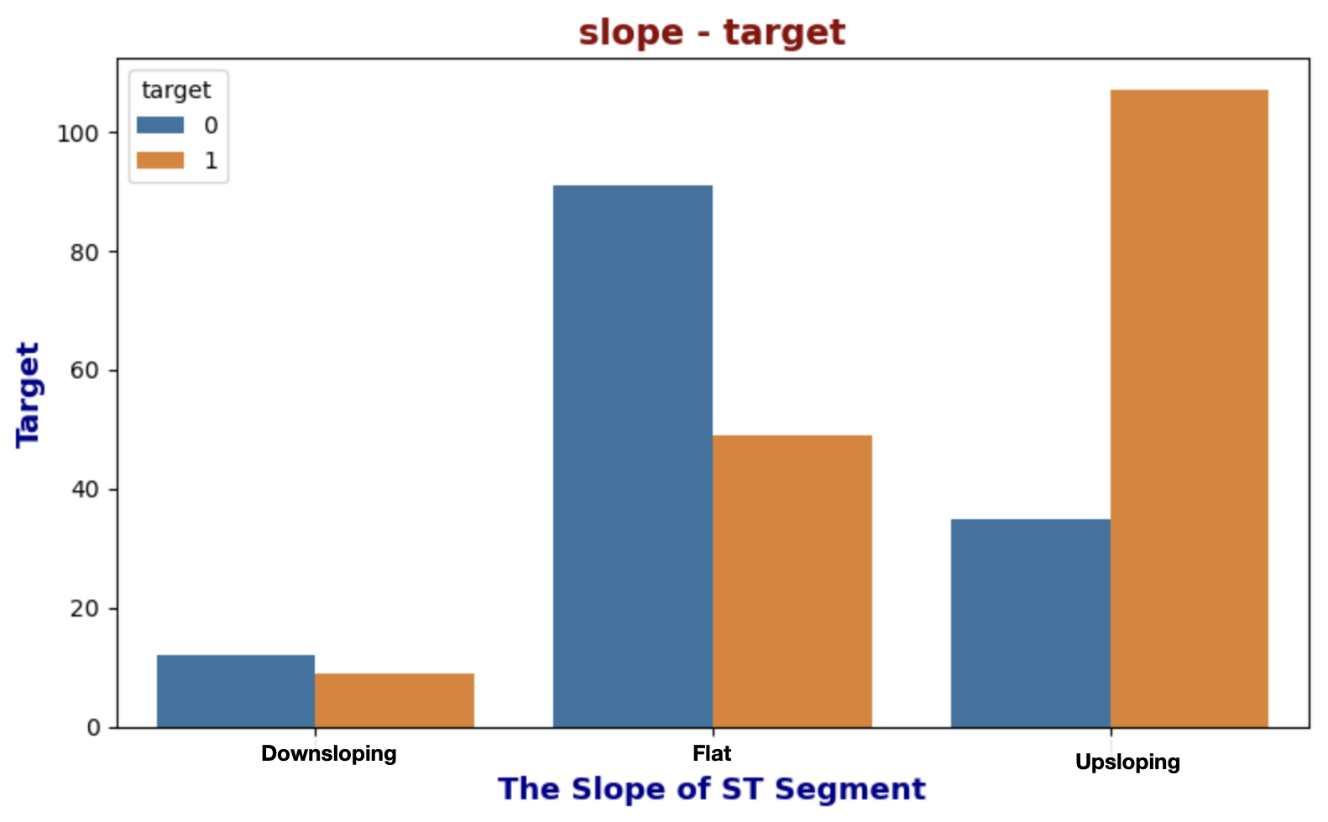

Slide 14
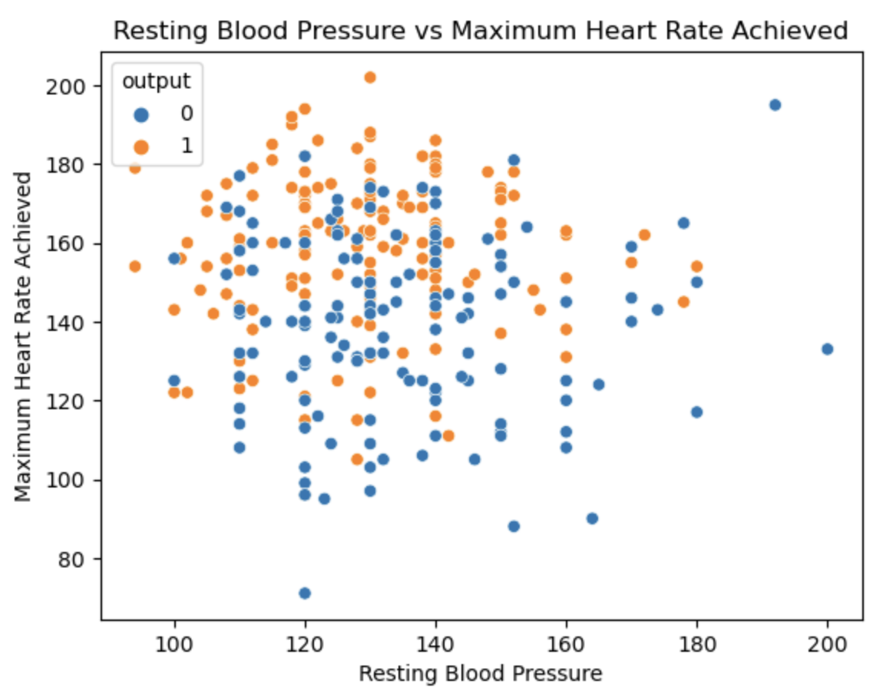
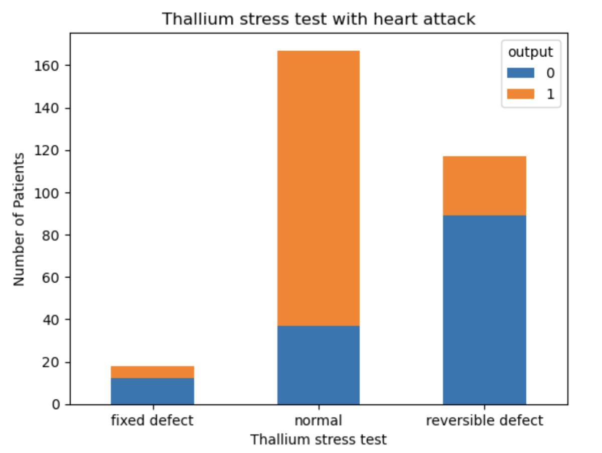
Multivariate Analysis

Slide 15
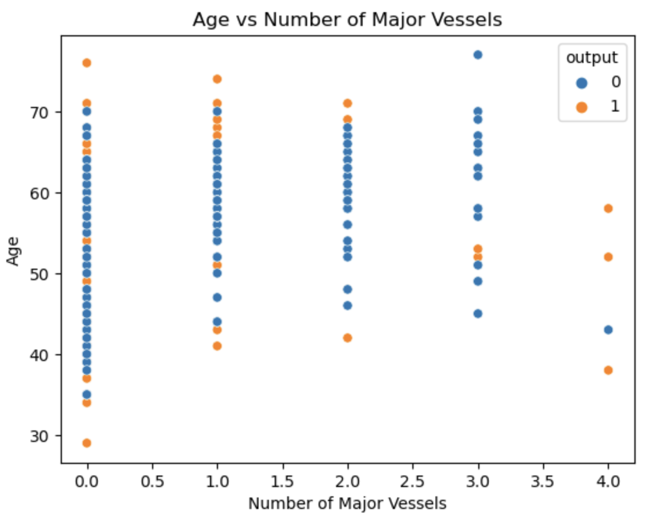
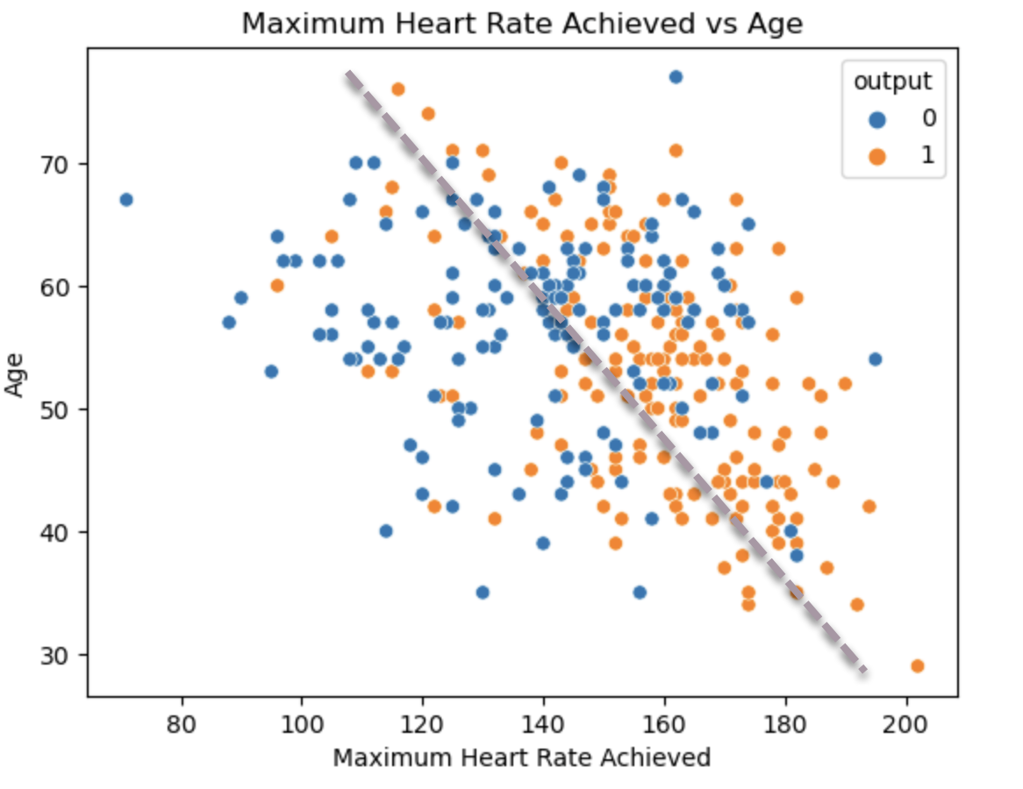

Slide 16
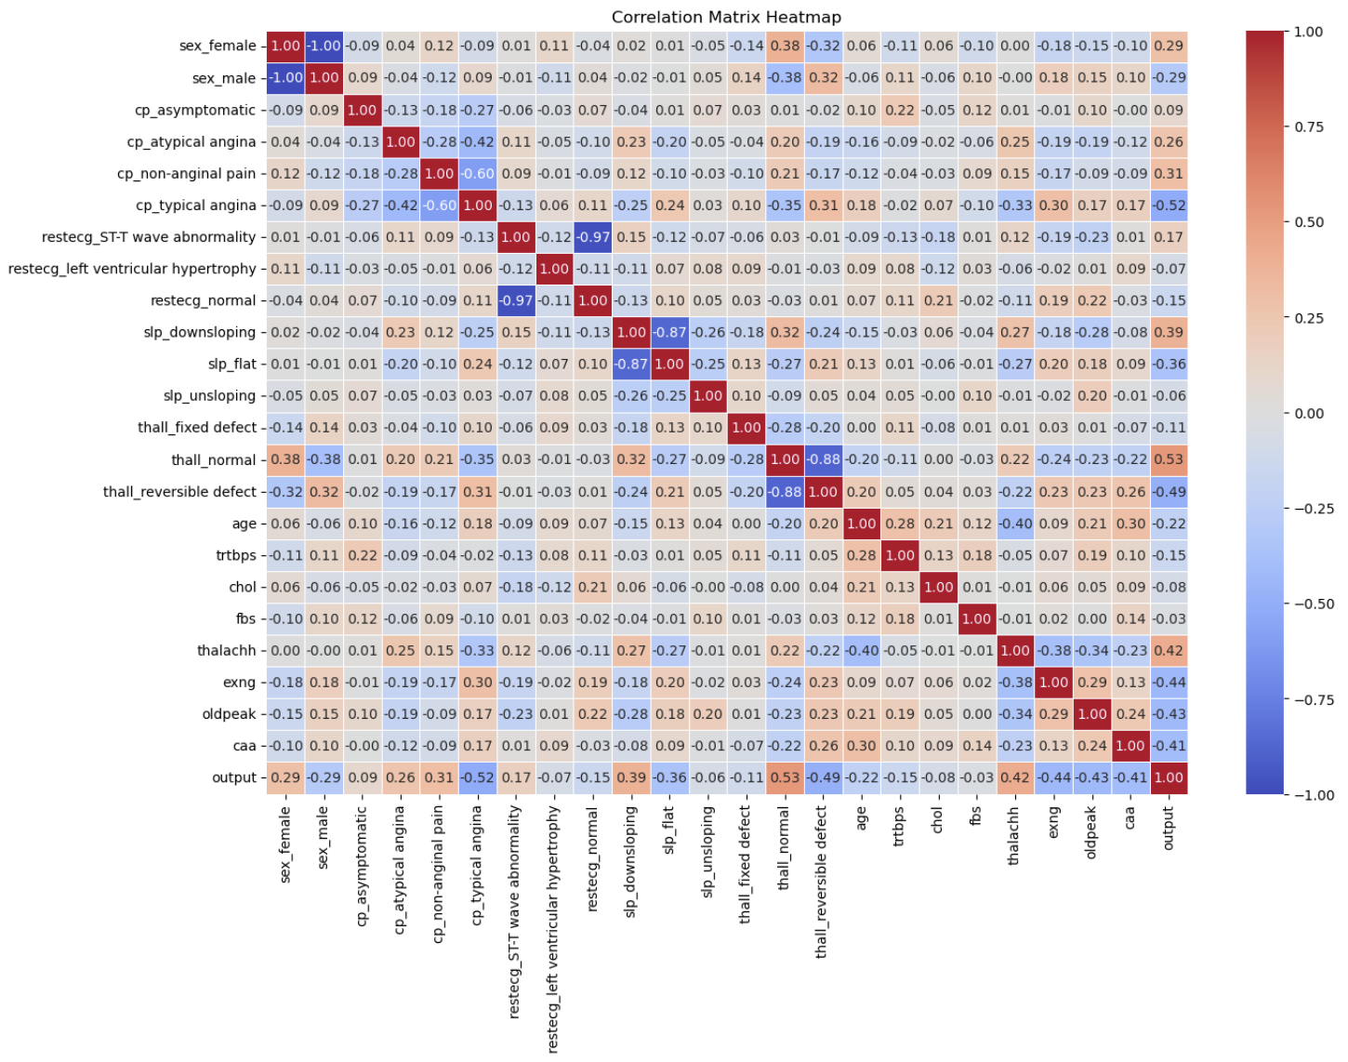
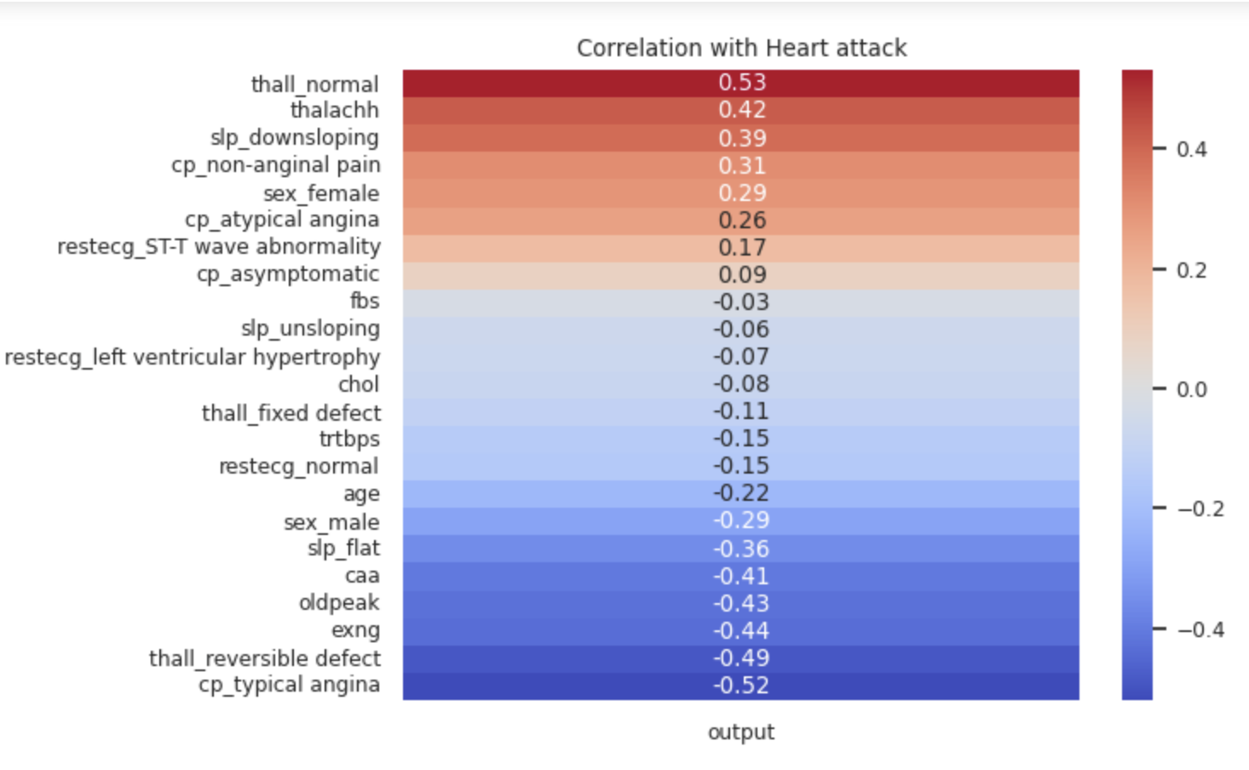
Correlation

Slide 17
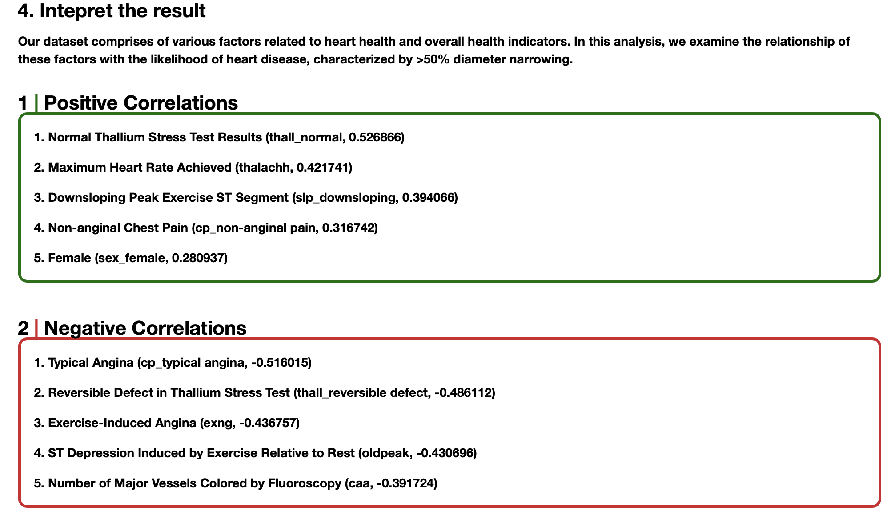
Result Interpretation

Slide 18
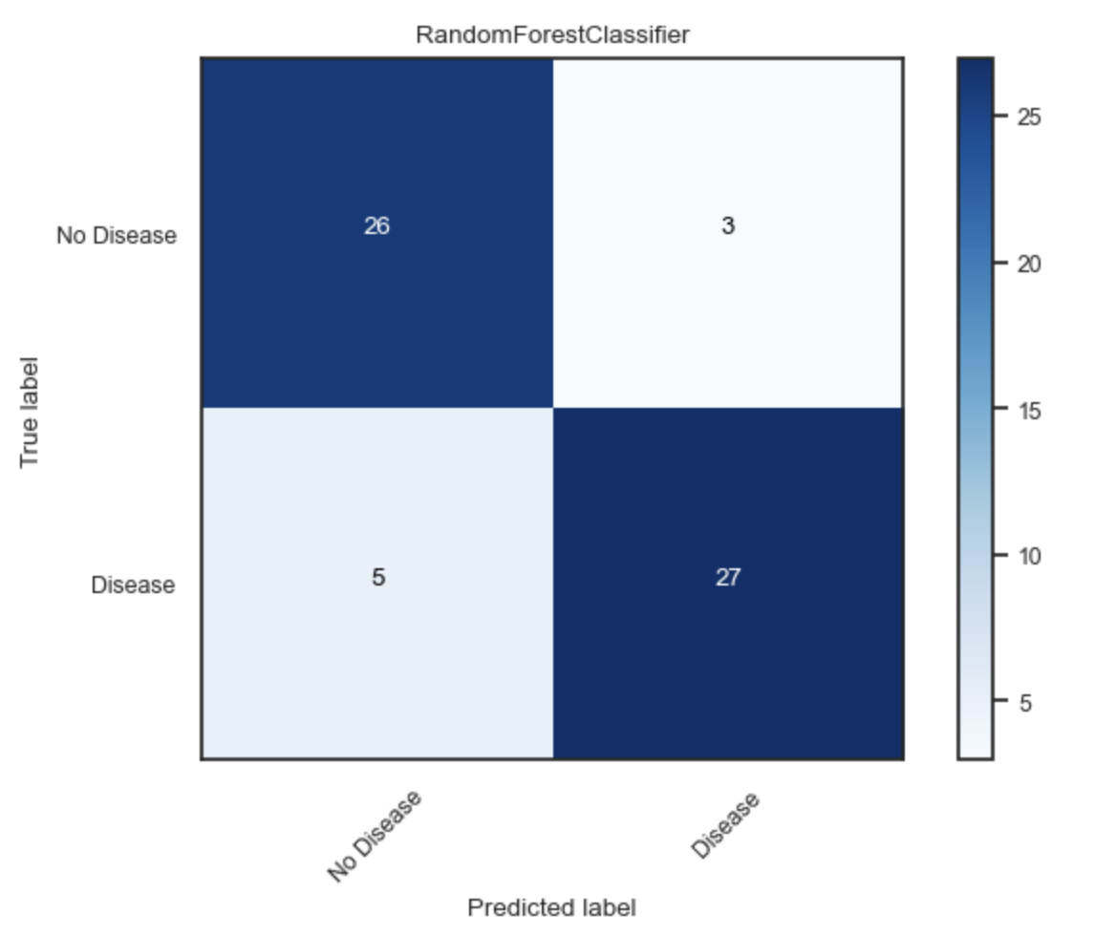
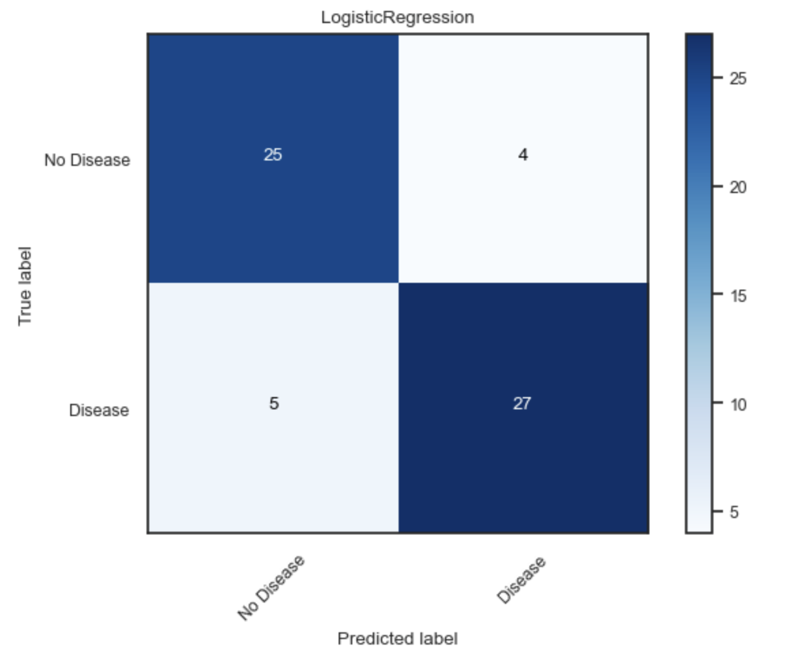
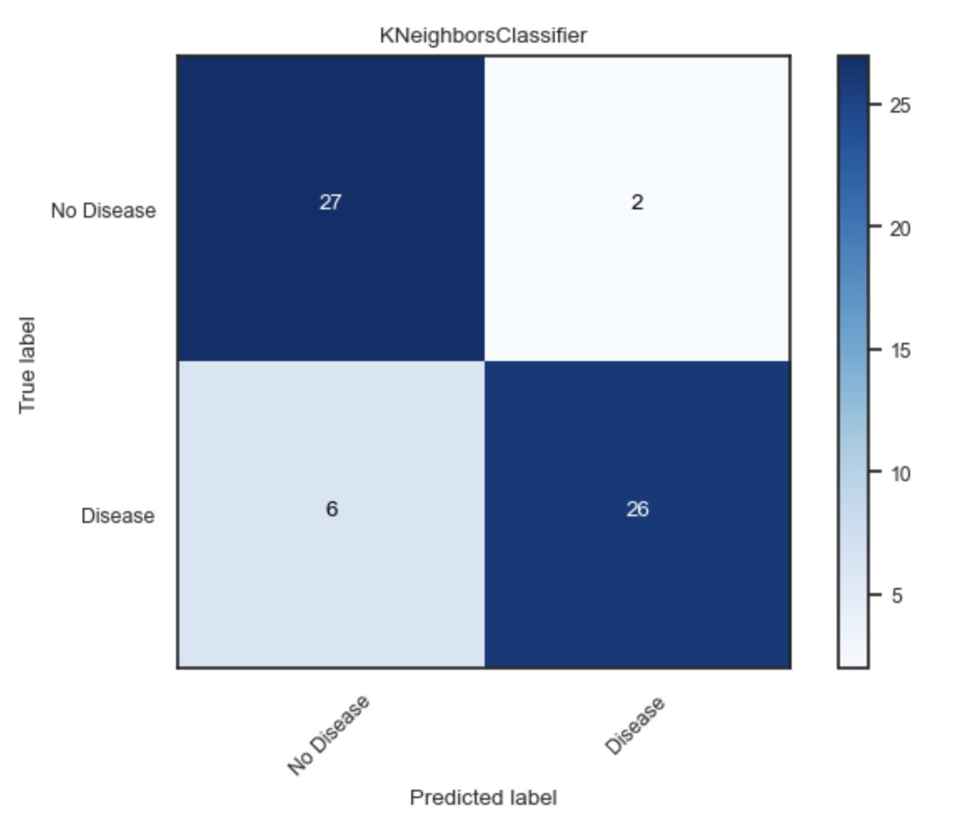
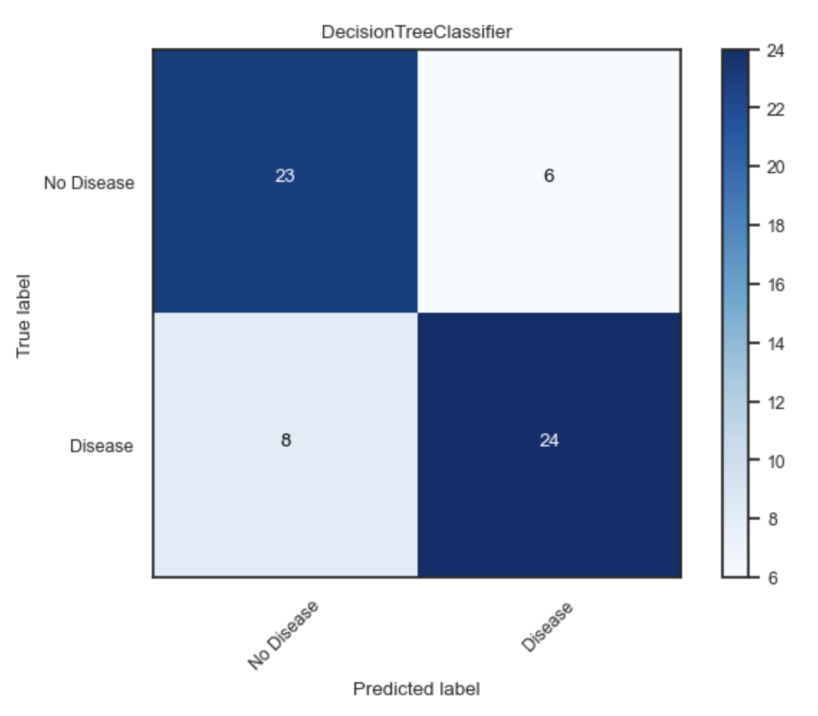
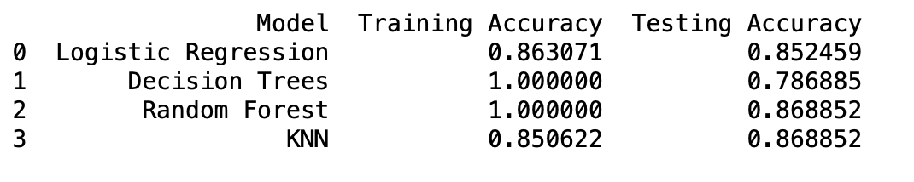
Predictive Analysis

Slide 19
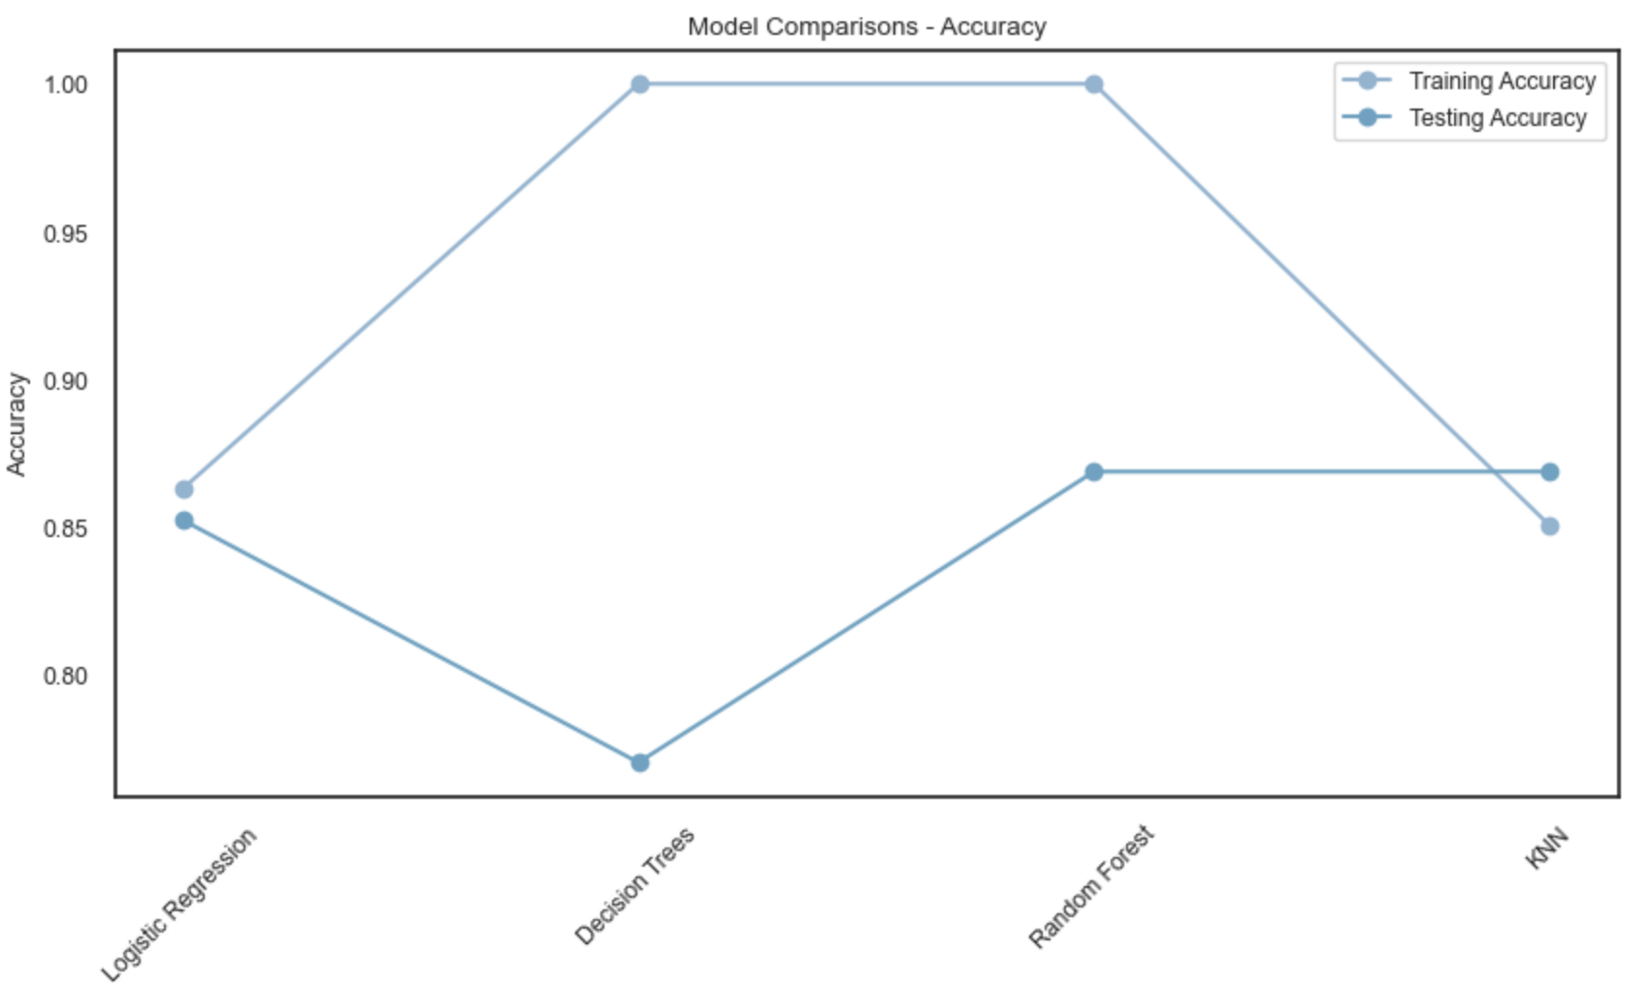
Model Accuracy

Slide 20
Summary
Our goal was to build a heart disease prediction model and compare the performance of various machine learning algorithms. The performance of the models was evaluated based on their training and testing accuracy. Here's a summary of the results we obtained:
Logistic Regression : This model had a training accuracy of 86% and a testing accuracy of 85%. This indicates that the model generalized well on unseen data and didn't overfit the training set.
Decision Tree Classifier : The model achieved a perfect training accuracy of 100%, but the testing accuracy dropped to 80%. This discrepancy suggests that the decision tree model overfitted the training data.
Random Forest Classifier: Like the decision tree model, the random forest model also achieved a perfect training accuracy of 100%. However, its testing accuracy was higher at 87%, suggesting better generalization compared to the decision tree model.
K-Nearest Neighbors (KNN): The KNN model achieved a training accuracy of 85% and testing accuracy of 87%. The higher testing accuracy compared to the training accuracy suggests that the KNN model was able to generalize well on unseen data.
In conclusion, the RandomForestClassifier, KNeighborsClassifier achieved the highest testing accuracy of 87%, suggesting that these models were the most successful at predicting heart disease based on the given dataset. However, caution should be exercised with the RandomForestClassifier due to their perfect training accuracy, which may be a sign of overfitting, despite their high testing accuracy.
In real-world applications, it would be beneficial to perform further analysis, such as tuning hyperparameters and using techniques such as cross-validation to validate the results. The interpretability of the model may also be an important factor to consider, in which case simpler models like Logistic Regression or Decision Trees may be preferred even though they might have slightly lower accuracy.

